Slide 1
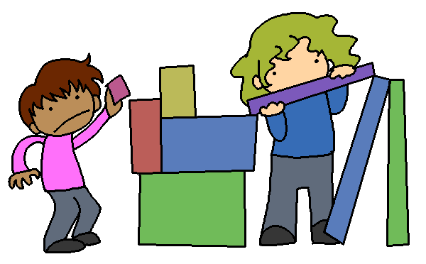
Building HTML
CS/IT 490 WD, Fall 2013

Slide 2
Breakdown
Tools!
Structuring your webpage

Slide 3
Tools!
Make sure you have a good text editor with syntax highlighting when writing your HTML!
Lighter weight:
  Notepad++
  Geany
These are completely fine!
Heavier weight:
  Eclipse
  Aptana Studio
  NetBeans

Slide 4
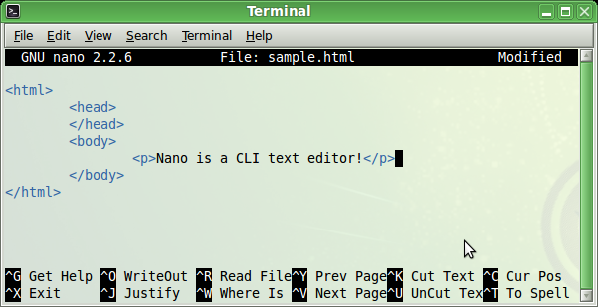
Tools!
Command Line Interface tools:
  Nano
  Vim
  Emacs
*nix Text Editors:
  Gedit
  Kate
  Kwrite
  Many things

Slide 5
Tools!
Don't use the version of Notepad that comes with Windows.
It has no syntax highlighting
It doesn't auto-tab
It only stores an undo history of 1 command!

Slide 6
Structuring your webpage
Even when you know CSS, you should begin working on a webpage by just working on the HTML first.
Think about the markup's structure and the layout you want before messing with any styling!
Keep the markup clean! Indent! Whitespace is OK!

Slide 7
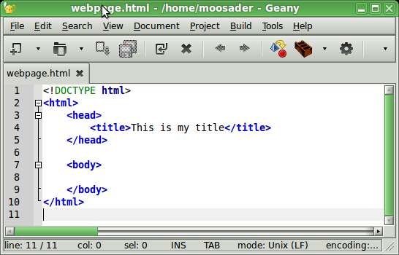
Structuring your webpage
Start with your core markup:

Slide 8
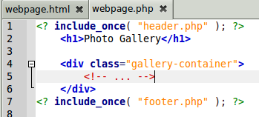
Structuring your webpage
When we start using PHP, we can extract all of the duplicate code (<head> contents, nav bar, etc.) and just have unique code in each .php page

Slide 9
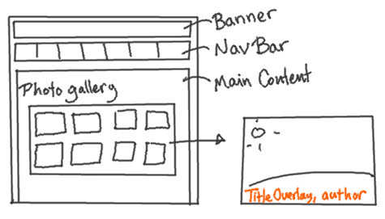
Structuring your webpage
Make sure you have an idea for a page layout first. Know how things should be split up on the webpage.

Slide 10
Structuring your webpage
What is in the body?
Banner bar
Navigation bar
Navigation buttons
Main content region
Photo gallery container
Photo thumbnails with title/author overlay

Slide 11
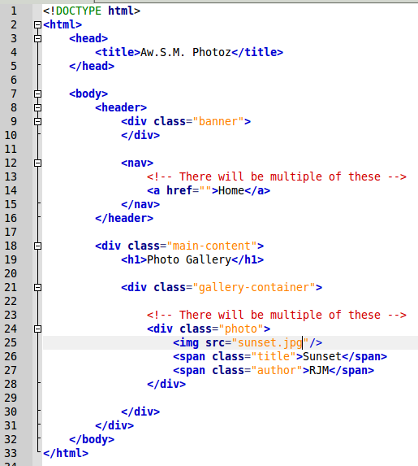
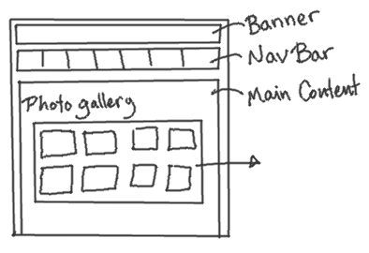
Sample markup -->

Slide 12
Notice that the header has been contained within the HTML5 <header> tags.
The navbar & links go within the <nav> tag (also HTML5)

Slide 13
As you build the markup, make sure to add classes to your divs and spans.
For now, think of them as labels for what they contain.
In CSS, we can target these classes and style them in a specific way.

Slide 14
You'll usually want to create some sort of “main content” div to store all your webpage's content in.
You will also want to create “container” divs for anything relatively complex, such as this photo gallery – There will be many photos displayed, so we want to wrap it in a container so we can keep the style sane.

Slide 15
Note that, for now, this will display an image and some text without any overlap.
This will be changed in CSS so that the text overlays the image nicely.
All this is within a “photo” class div to help simply positioning once we get into the CSS.
Don't be afraid to make containers!

Slide 16
It takes practice, but you'll gain foresight as you work on webpages – thinking about how the CSS and PHP interconnect.

Slide 17
References
-

